Slide 1
Module 1: An Overview of United Nations Peacekeeping Operations
Lesson
1. 2
Peace and Security Activities

Slide 2
Relevance
Personnel work in a wider frame – peacekeeping is:
Unique and important
One of many UN peace and security activities
Connected to other UN security, development, humanitarian and human rights work
UN Core Pre-Deployment Training Materials 2017

Slide 3
Learning Outcomes
Learners will:
Describe five peace and security activities
Explain differences between “robust peacekeeping” and “peace enforcement”
Explain differences between traditional and multidimensional peacekeeping
Identify Security Council as authorizing body
UN Core Pre-Deployment Training Materials 2017

Slide 4
Lesson Overview
Spectrum of Peace & Security Activities
Linkages & Overlaps in Peace & Security Activities
Different Types of Peacekeeping Operations
Special Political Missions
UN Core Pre-Deployment Training Materials 2017

Slide 5
Learning Activity
1.2.1
Experiences of Conflict
Instructions:
Give examples of conflict in everyday life
How do we stop conflict from getting out of control?
Compare with conflict between and within States
Time: 10 minutes
Brainstorming: 3 minutes
Discussion: 5-7 minutes
UN Core Pre-Deployment Training Materials 2017

Slide 6
1. Spectrum of Peace and Security Activities
Conflict Prevention
Pre-Conflict
Conflict
Peacemaking
Peace Enforcement
Peacebuilding
Peacekeeping
Cease-fire
Political Process
Post-Conflict
UN Core Pre-Deployment Training Materials 2017

Slide 7
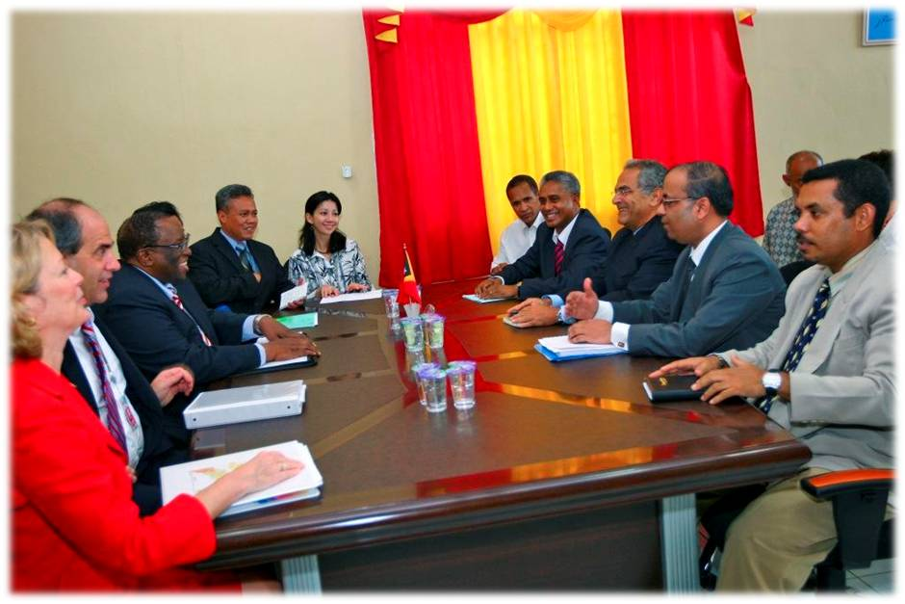
Conflict Prevention
Before conflict
Diplomatic measures and other tools to prevent violent conflict
UN Core Pre-Deployment Training Materials 2017

Slide 8
Peacemaking
Conflict exists
Diplomatic action bringing hostile parties to an agreement
UN Core Pre-Deployment Training Materials 2017

Slide 9
Peace Enforcement
Conflict exists
Coercive measures, such as sanctions or blockades
Armed force only with Security Council authorization
Authorized without consent of conflict parties
UN Core Pre-Deployment Training Materials 2017

Slide 10
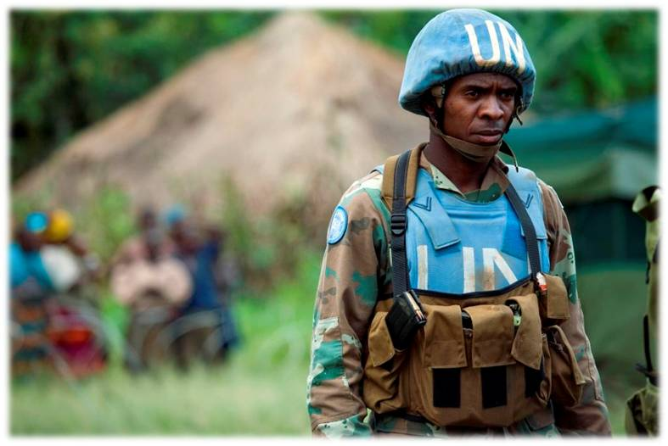
Peacekeeping
Preserves peace when conflict ends
Implements peace agreement
Authorized with consent of conflict parties
UN Core Pre-Deployment Training Materials 2017

Slide 11
Peace Enforcement vs. Robust Peacekeeping
Peace Enforcement | Robust Peacekeeping
International level Without consent Force: sanctions, blockades or armed force | Field level With consent Force: armed force
UN Core Pre-Deployment Training Materials 2017

Slide 12
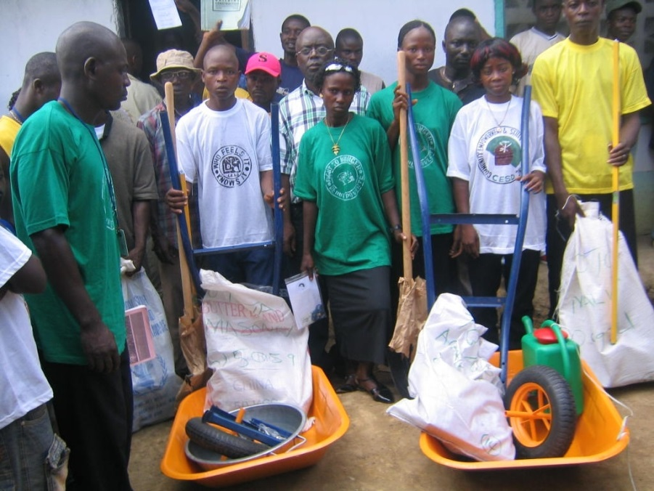
Peacebuilding
Aftermath of conflict
Long-term process, creates conditions for lasting peace, works on root causes of conflict
UN Core Pre-Deployment Training Materials 2017

Slide 13
2. Linkages and Overlaps in Peace
and Security Activities
Conflict Prevention
Pre-Conflict
Conflict
Peacemaking
Peace Enforcement
Peacebuilding
Peacekeeping
Cease-fire
Political Process
Post-Conflict
UN Core Pre-Deployment Training Materials 2017

Slide 14
Learning Activity
1.2.2
UN Responses to Conflict
Instructions:
Consider the scenario of an evolving conflict
How can the international community or UN intervene?
Time: 10 minutes
Group work: 5-7 minutes
Discussion: 3 minutes
UN Core Pre-Deployment Training Materials 2017

Slide 15
3. Different Types of Peacekeeping Operations
UN Core Pre-Deployment Training Materials 2017

Slide 16
3. Different Types of Peacekeeping Operations
Traditional peacekeeping
Multidimensional peacekeeping
Transitional authority
UN Core Pre-Deployment Training Materials 2017

Slide 17
Traditional vs Multidimensional Peacekeeping
Traditional Peacekeeping | Multidimensional Peacekeeping
Military tasks Military personnel No direct role in political efforts | Diverse tasks Military, civilian, police personnel Direct role in political efforts
UN Core Pre-Deployment Training Materials 2017

Slide 18
Transitional Authority
Multidimensional peacekeeping
Temporary state functions
UN Core Pre-Deployment Training Materials 2017

Slide 19
4. Special Political Missions
UN Core Pre-Deployment Training Materials 2017

Slide 20
Learning Activity
1.2.3
Traditional vs. Multidimensional Peacekeeping
Instructions:
Consider different cases of UN peacekeeping
What type is it?
Time: 5 minutes
Discussion: 3 minutes
Wrap-up: 2 minutes
UN Core Pre-Deployment Training Materials 2017

Slide 21
Summary of Key Messages
5 peace and security activities – before, during, after conflict
“Robust peacekeeping” vs. “peace enforcement” – differences in levels, consent, use of force
Traditional vs. multidimensional peacekeeping – different tasks, personnel, roles in political efforts
The Security Council is the authorizing body
UN Core Pre-Deployment Training Materials 2017

Slide 22
Questions
UN Core Pre-Deployment Training Materials 2017

Slide 23
Learning Activity
Learning Evaluation
UN Core Pre-Deployment Training Materials 2017

